Slide 1


STARTER UNIT
LESSON 3

Slide 2



Slide 3
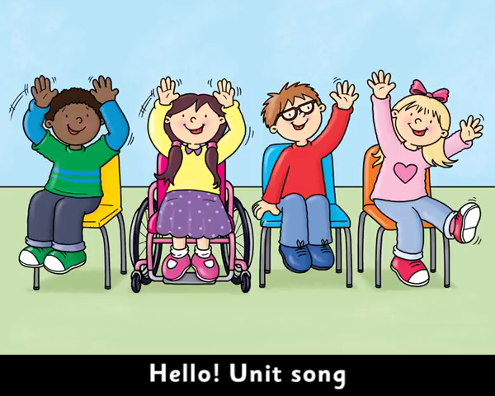

Slide 4
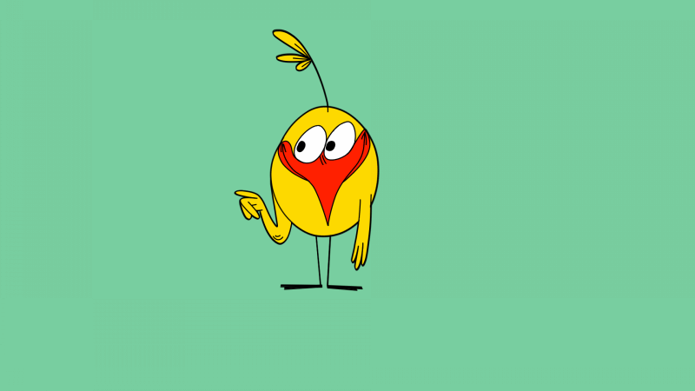
LISTEN AND POINT

Slide 5

read a comic

Slide 6

watch TV

Slide 7
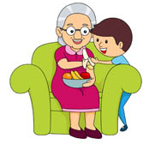
visit his grandma

Slide 8
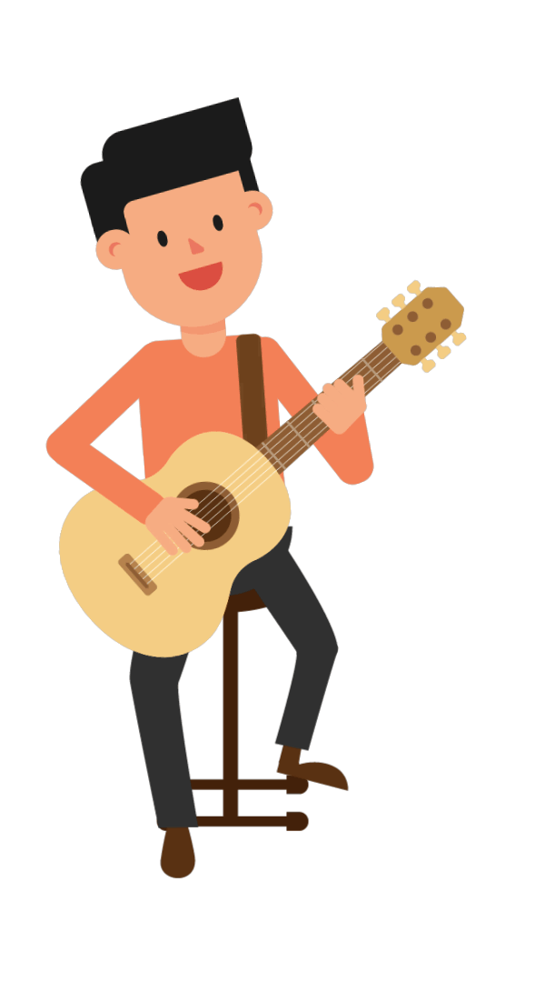
play the guitar

Slide 9
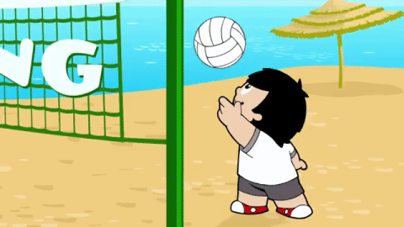
play volleyball

Slide 10
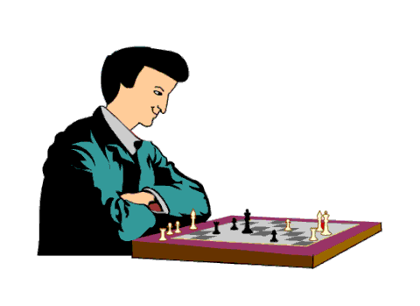
play chess

Slide 11

LISTEN AND REPEAT

Slide 12
read a comic

Slide 13
watch TV

Slide 14
visit his grandma

Slide 15
play the guitar

Slide 16
play volleyball

Slide 17
play chess

Slide 18
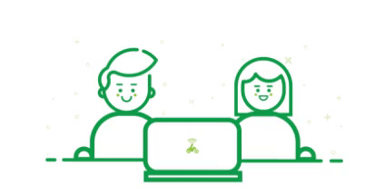
WORK IN PAIRS

Slide 19
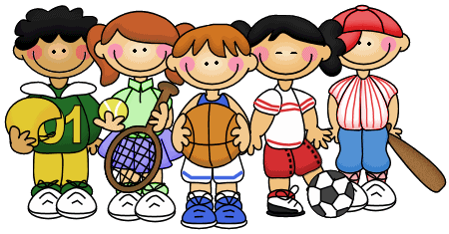

WHAT ARE THEY GOING TO DO ?

Slide 20


What is she going to do?
GREAT
She is going to sleep.
She is going to cook.
She is going to sing.

Slide 21


What’s he going to do?
GREAT
He’s going to feed
the fish.
He’s going to eat.
He’s going to bed.

Slide 22

What are you going to do ?
GREAT
I’m going to cook.
I’m going to dance.
I’m going to taste
an apple.

Slide 23


What are they going to do?
GREAT
They are going to work.
They are going to swim.
They are going to run.

Slide 24

What are you going to do?
GREAT
I’m going to visit Jim.
I’m going to do yoga.
I’m going to play.

Slide 25

What’s she going to do?
GREAT
She’s going to sleep.
She’s going to read.
She’s going to write.

Slide 26

What are you going to do?
GREAT
I’m going to work.
I’m going to sing.
I’m going to dance.

Slide 27

What are you going to do?
GREAT
We are going to read.
We are going to surf.
We are going to skate.

Slide 28

What’s he going to do?
GREAT
He’s going to drink.
He’s going to drive
the bus.
He’s going to dive.

Slide 29

What are you going to do?
GREAT
I’m going to eat
an ice cream.
I’m going to drink.
I’m going to write.

Slide 30

What are you going to do?
GREAT
We’re going to make a
cake.
We’re going to make a
sandcastle.
We’re going to make a
snowman.

Slide 31

What’s she going to do?
GREAT
She’s going to listen
to music.
She’s going to sell
a book.
She’s going to open
the gift.

Slide 32

What’s she going to do?
GREAT
She’s going to fly
a kite.
She’s going to fly
a plane.
She’s going to fly
like a bird.

Slide 33

What are you going to do?
GREAT
I’m going to wash
the dishes.
I’m going to have
a shower.
I’m going to wash
my hands.

Slide 34

What are you going to do?
GREAT
We are going to play
tennis.
We are going to play
baseball.
We are going to play
football.

Slide 35


Slide 36
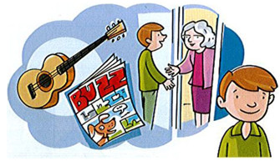
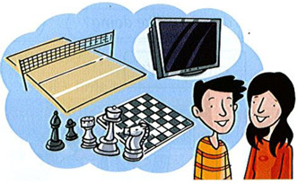
Ask and answer read a comic, watch TV, visit his grandma, play the guitar, play volleyball, play chess.
 | A. What's he going to do on the weekend? B. He's going to…..
 | A. What are they going to do? B. They're going to…

Slide 37
Write about what you are going to do on the weekend.
On the weekend, I'm going to……

Slide 38
WORK IN PAIRS

Slide 39

WORKBOOK TIME

Slide 40

GOODBYE!!!

Slide 41


